Slide 1



MY SUGAR GENETICS
Comprehensive Diabetes Genetic Risk Screening with Pharmacogenomics
Chandra Meruva

Slide 2
PATIENT INFORMATION
Patient Name: Chandra Meruva
Age: 50
Sample Details:
Gender: Male
Collection Date | 18 Nov 2024
Type of sample | Buccal swab
Genomic Specimen ID | KHDEOMGPCSP11
Sequencing Details:
Sequencing Type | Germline
WGS/WES/Targeted Seq | Whole Exome Sequencing
Encoding | Illumina 1.9
Sequence length | 151bp
Overall Alignment rate | 99.90%
Mean Sequencing depth | 223.0
Q30 score | 93.59%
INDICATION FOR TESTING
Chandra Meruva, 50, Male was referred for genetic testing to analyze risk for Diabetes.

Slide 3


Date: 10 Dec 2024
Dear Chandra Meruva,
Welcome to My Sugar Genetics, a comprehensive and personalized genetic analysis powered by advanced DNA sequencing technologies, including Next-Generation Sequencing (NGS). This cutting-edge analysis is designed to equip you and your healthcare team with vital insights into your genetic predisposition to diabetes and its potential complications.
Our in-depth DNA data analytics uncover how your unique genetic profile influences critical aspects like diet response, metabolism, and lifestyle and assess your risk for diabetes-related complications such as nerve, kidney, and eye damage. Early detection through genetic screening helps you take proactive steps to prevent or delay these complications, safeguarding your long-term health.
Additionally, we delve into the exciting field of pharmacogenomics, identifying how your genes influence your response to diabetes medications. This ensures your treatment plan is optimized for maximum effectiveness and minimal side effects, providing a truly personalized approach to diabetes care.
At My Sugar Genetics, we are dedicated to empowering you with the knowledge and tools needed to make informed decisions about your health. Our genetics-driven strategies offer tailored recommendations to help you manage, mitigate, and outsmart diabetes risks.
Thank you for trusting My Sugar Genetics as your partner in health. Together, let’s navigate your path to a healthier, complication-free future. We’re here to support you every step of the way.
Warm Regards

Slide 4
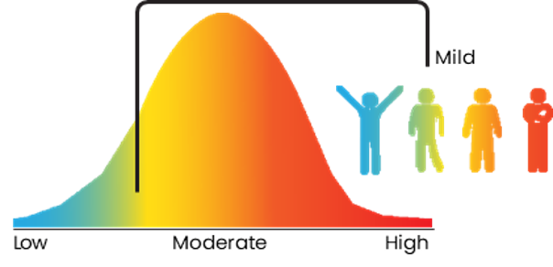
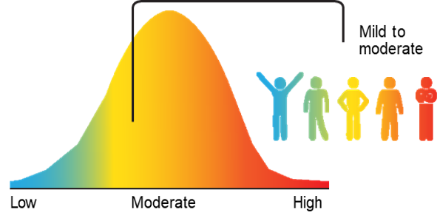
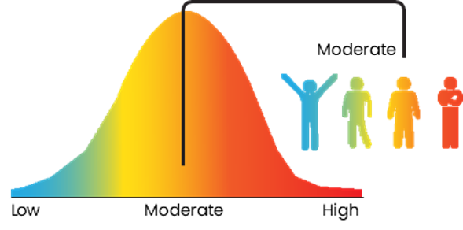
YOUR “SUGAR-GENETICS” SUMMARY
Comprehensive Diabetes Risk
Genes Analyzed: 112
Variants analyzed: 4320
Insulin Resistance
Genes Analyzed: 98
Variants analyzed: 3760
Exercise Intolerance
Genes Analyzed: 141
Variants analyzed: 2746
Findings are statistically signiﬁcant at a 95% conﬁdence level

Slide 5




Decode, Defend - Diabetes Complications
Genetic screening empowers you to predict, prevent, and protect against diabetes-related challenges.
Diabetic
Nephropathy
Genetic screening helps identify variations that increase the risk of kidney damage in diabetes, enabling early interventions to protect kidney health.
Diabetic Neuropathy
Screening for genetic markers can reveal predispositions to nerve damage, allowing better management and prevention of complications like pain or loss of sensation.
Diabetic Retinopathy
Genetic testing detects risk factors for vision-threatening eye damage in diabetes, supporting timely monitoring and treatment to preserve sight.
Findings are statistically significant at a 95% confidence level

Slide 6
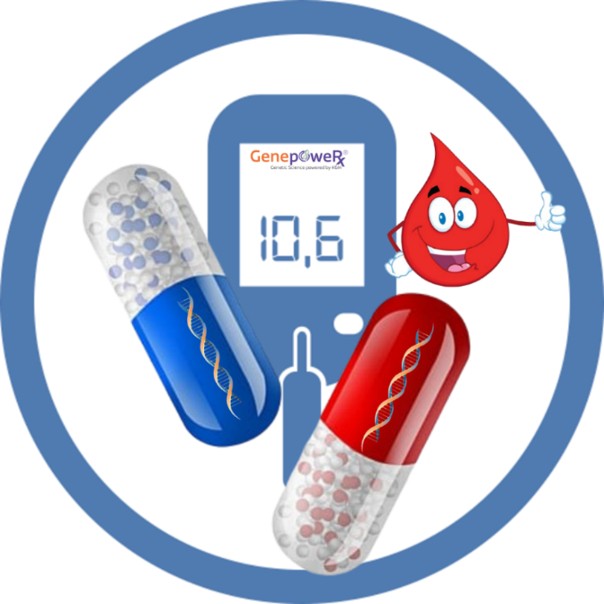
Your DNA’s Prescription Plan for Diabetes
Diabetic - Therapeutic Recommendations
Drug | Use with caution | Use as Directed | Dosage Adjustment recommended
Biguanides
Metformin
Thiazolidinedione
Rosiglitazone
Pioglitazone
Glinides
Repaglinide
DPP4 Inhibitors
Sitagliptin
Vildagliptin
Sulfonylureas
Gliclazides
Glibenclamide
Tolbutamide
Glimepiride
Glipizide
Gliquidone

Slide 7
Antiplatelet Agents - Therapeutic Recommendations
Drug | Use with caution | Use as Directed | Dosage Adjustment recommended
Clopidogrel
Aspirin
Prasugrel
Aspirin+Clopidogrel
Ticagrelor
CPIC Guidelines for Antiplatelet therapy recommendations
(When considering clopidogrel for cardiovascular and neurovascular indications based on CYP2C19 status)
Phenotype | Poor metabolizer
Genotype | An individual carrying two no function alleles
Diplotype | *2/*2
Implications | Significantly reduced clopidogrel active metabolite formation; increased on-treatment platelet reactivity; increased risk for adverse cardiac and cerebrovascular events
Therapeutic recommendations | Avoid clopidogrel if possible. Use prasugrel or ticagrelor at standard dose if no contraindication.
Classification of Recommendations | Strong
Other recommendations | Alternative P2Y12 inhibitors not impacted by CYP2C19 genetic variants include ticagrelor and ticlopidine. Prasugrel is contraindicated in patients with a history of stroke or TIA/for neurovascular indications.
To note: *2, *3, *17 are considered due to strong scientific evidence. *4 to *8 alleles of CYP2C19 are not weighed.

Slide 8
Cholesterol Meds - Therapeutic Recommendations
Drug | Use with caution | Use as Directed | Dosage Adjustment recommended
Rosuvastatin
Fluvastatin
Lovastatin
Atorvastatin
Pitavastatin
Simvastatin
Pravastatin
Fenofibrate
CPIC Guideline HMG CoA REDUCTASE INHIBITORS (STATINS)
(Recommended dosing of Statins based on SLCO1B1 phenotype)
Phenotype | Normal function
Genotype | An individual carrying two normal function alleles
Diplotype | *1/*1
Implications | Typical myopathy risk and statin exposure
Dosing recommendations | Prescribe desired starting dose and adjust doses based on disease-specific guidelines
Classification of Recommendations | Strong

Slide 9


You have mild genetic risk for diabetes, as no mutations have been detected in any of the major genes involved in the pathology of diabetes. However, there are mutations seen for carbohydrate intolerance and glucose metabolism.
You have mild to moderate risk for insulin resistance, as there are a few homozygous mutations seen in LEPR gene. This can lead to abdominal weight gain and cause impaired glucose uptake.
You have a moderate intolerance for exercise, as there are mutations seen for collagen related genes and in NLRP1 gene. These can lead to joint pain issues. Maintain a regular exercise regimen which is more focused on musculoskeletal strengthening.
You are less likely to have diabetes related eye complications. Yearly eye exam is recommended with an Ophthalmologist.
You have low genetic risk for diabetes related neuropathy, and hence you are less likely to have symptoms of tingling or numbness in the extremities. However, it is recommended that you maintain blood sugar levels within range.
You have a low genetic risk for diabetes related kidney damage. Monitor Blood urea nitrogen and serum creatinine levels every year.

Slide 10
Your Fitness and Nutrition Genes
Carbohydrate , Lipid , Protein, Musculoskeletal Metabolism
MUTATIONS SEEN IN GENES | RECOMMENDATIONS
ACSF3, CUBN, MCEE, MTHFR, ZNF143 | • Include dark green leafy vegetables, Vitamin B12 rich foods (Eggs, Fish, seafood).
AGA | • Include Calcium rich foods.
COQ4, COQ6, COQ7 | • Include foods like oranges, strawberries, soybeans, lentils, peanuts.
NLRP12 | • Avoid excessive cold exposure, ingestion of cold foods. Avoid excessive stress.
ACADSB, GATM | • Avoid excessive workout. Include a diet rich in complex carbohydrate. • Avoid heavy workouts. Please ensure to include foods like Pumpkin seeds, Walnuts, Peanuts, Almonds, Eggs, Buttermilk.
CDH23 | • Recommend yearly eye exam and hearing tests after age 50
ARSA | • Include foods with complex carbohydrates. Fats to constitute only 20% of the total meal.
CRACR2B | • Avoid high fat diets and prolonged periods of fasting. Include riboflavin supplementation or riboflavin rich foods like eggs, dairy, green vegetables, fish.
ACOX1, PEX16, PEX2, PEX6, PHYH | • Include Fish Oil supplements.
FLVCR1 | • Include foods which improve iron stores like dates, legumes, dark green vegetables. Poor oral absorption of iron seen with this mutation. Recommend monitoring CBC and Iron profile yearly.

Slide 11
Your Fitness and Nutrition Genes
Carbohydrate , Lipid , Protein, Musculoskeletal Metabolism
MUTATIONS SEEN IN GENES | RECOMMENDATIONS
BCKDHA, PDHX | • Avoid high protein meals/ powders. Increase intake of thiamine rich foods, like whole wheat, unpolished rice, millets. • Include thiamine rich foods like brown rice, legumes, whole grains
ANK2, CACNA1C-AS1, D2HGDH, KCNJ5, RBM20, RYR1 | • Prefer exercises like brisk walking, strength training with lesser weights. Avoid Fasting
ENO3, GAA, GYG2 | • Need a pre workout snack rich in complex carbohydrates as glucose may not be readily available during work outs. Ideas for snacks include a banana, idli with peanut chutney, pomegranate, Avocado toast, oatmeal, almonds, walnuts. Make sure to eat the snack at least 45 minutes before work out.
DPM2 | • After work out, include a meal rich in complex carbohydrates and proteins.
IFITM5, VDR | • Include phosphate rich foods like sunflower seeds, pumpkin seeds, buttermilk, aged cheese, green leafy vegetables, beans
COL2A1, COL6A2, COL6A3, NEB | • To avoid muscle cramps after strenuous workouts, include foods like bone broth, nuts, beans, fish, broccoli, whole grains.
CDH23 | • Milk, fresh cheeses, fresh milk cream can cause symptoms of bloating, malabsorption. Avoid fresh dairy. Can include buttermilk, aged cheeses. Increase consumption of fruits.
ETFB, FBP1 | • Strictly avoid KETO diets. Avoid prolonged periods of fasting. Fructose overload with processed drinks and artificially sweetened foods can cause malabsorption and change of the gut bacterial flora. This can lead to decreased immunity, allergies.

Slide 12



Your Vitamins Summary
Analysis For SCORE
Supplements
Vitamin-B12
Essential
Vitamin-B9 Folic Acid
Essential
Vitamin-C
Optional
Vitamin-B1
Advised
Vitamin-B2
Optional
Vitamin-B6 Biotin
Essential
Vitamin-E
Essential
Vitamin-D
Essential
Vitamin-K
Optional

Slide 13
Your Minerals Summary
Analysis For SCALE
Supplements
Iron
Essential
Magnesium
Advised
Molybdenum
Essential
Phosphate
Advised
Calcium
Essential
Zinc
Essential
Consult your healthcare provider before use; individual results may vary.

Slide 14




Your Gene guide for healthy living
Avoid
excessive cold exposure, ingestion of cold foods, and stress. excessive or heavy workouts
high-fat diets. high-protein meal replacements, and powders.
prolonged periods of Fasting. keto diets, and fructose overload from processed drinks or artificially sweetened foods.
fresh dairy products like milk, fresh cheeses, or cream if bloating or malabsorption occurs.
neglecting proper nutrient-rich diets like riboflavin or iron supplementation.
Include
dark green leafy vegetables and Vitamin B12 rich foods (e.g., eggs, fish, seafood).
Oranges, strawberries, pomegranate, walnuts, almonds, and peanuts to your diet.
foods that improve iron stores, such as dates, legumes,
rich in complex carbohydrates, ensuring fats constitute only 20% of the total meal..
pumpkin seeds, walnuts, peanuts, almonds, eggs, and buttermilk.
calcium-rich foods.

Slide 15









Your Gene guide for healthy living
Recommendations
Riboflavin-rich foods (e.g., eggs, dairy, green vegetables, fish) to address deficiencies.
Regular yearly eye and hearing tests after age 50.
Vitamin B12 and folate supplementation to address deficiencies.
Include foods that prevent muscle cramps post-workout, like bone broth, nuts, beans, fish, broccoli, and whole grains.
Recommend monitoring CBC and iron profiles yearly for those with poor oral absorption of iron.
Monitor and maintain a balanced diet to avoid malabsorption issues or gut flora imbalance that could affect immunity.

Slide 16
TOP BIOMARKERS LISTED
CONDITION | BIOMARKERS
comprehensive diabetic risk | ABCC8, C1QTNF6, CEL, CTLA4, DNAJC3, DUT, GCK, HLADQ, HLADR, HNF1A, HNF1B, HNF4A, INS, INSR, KCNJ11, NEUROD1, PPARG, PRKCQ, RBP3, TCF7L2
Insulin Sensitivity | HNF1A, HNF4A, HNF1B, IPF1, NEUROD1, INS, ENPP1, LEPR, PCSK1, GCK, AGPAT2, BSCL2, CAV1, PTRF, LMNA, PPARG, CIDEC, ZMPSTE24, AKT2
Exercise Intolerance | FBN1, GYG1, RYR1, COMT, 5-HTT, MATN3, SMAD6, SLC26A2, COMP, NLRP1, FGFR1, FRZB, VDR, IL17F, IL-6, BMP2
Carbohydrate Intolerance | FBP1, FBP2, NEDD4L, PC, G6PC3, G6PC2, GCK, MPI, HMGCL, MANBA, ALG2, PMM2, GALNT3, ALG13, DOLK, DPAGT1, SLC35A2
Fat Intolerance | LEP, MC4R, IL6, POMC, MAP4K4, PPARG, ACADVL, MTTP, APOB, GATA1, CAD, HADHA, PCSK9, APOE, ASS1, SLC25A13, ARSD
Protein Intolerance | DBT, PPM1K, BCAT2, HPD, OTC, CPS1, AASS,ASS1, NAGS, ASL, TAT, SLC7A9, SLC3A1, SLC7A7, SLC6A19, ETHE1, SLC25A15, ACAT1, SLC26A2
Vitamins | AICDA,C4BPB, ABCD4, ACSF3, ACAD12, ACAD13, TPK1, SLC44A4, CPT2, CYB5R3, ACAT1, BTD, MTHFD1, ADA, SCAR-B1, VKORC1, ABCA1, GGCX
Minerals | PCBD1,SARS2, AGA, AP2S1, BSND, CACNA1S, BMP1, CA2, CLCN7, ACSF3, BBOF1, CD320, DMT1,SLC7A7, SLC39A8, XDH

Slide 17

EVIDENCE-BASED DIET PATTERN
This diet plan is designed based on the genomic insights from your genomic data. It focuses on optimizing health by strengthening your immune system, promoting weight management, and addressing risks for chronic conditions. These tailored guidelines empower you to make informed decisions for achieving and maintaining long-term well-being.

Slide 18








NUTRITION RECOMMENDATIONS
Carbohydrates
Grains which can be included in diet- Include Thiamine rich foods like Hand pounded rice, Single polished rice, Whole wheat ﬂour, Millets (any kind), Quinoa.
Hand pounded rice, basmati rice, whole wheat. 6-7 days/week
Millets – 4-5 days/week
Fats
Indian cooking- Use cold pressed Peanut oil, Sesame oil, Ghee.
Salads and stir fry- Extra Virgin Olive Oil
Proteins
Legumes-Any variety. 5-6 days/week Soy bean, Rajma, black eyed peas -1 day/week
Green moong dal sprouts- once week
Meat products- Eggs 4-5 days/week Chicken/Red meat once a week Seafood once or twice a week
Vegetables
Include all varieties of vegetables. 4 days/week
Prefer- Beans, carrots, beetroot, Gourds
Dark green leafy vegetables like Spinach, Mustard greens. 5 days/week
Avoid monotonous meals
Dairy
Prefer buttermilk- 2 cups daily. 6-7 days/week
Avoid fresh cheeses, butter
Milk based beverages (Tea, Coffee)- not more than 1 cup a day

Slide 19





NUTRITION RECOMMENDATIONS
Fruits
Include all seasonal fruits. 5 days/week
Avoid fruit juices, instead eat the whole fruit.
Spices
Reduce salt and chili powder. Rest of the spices okay.
Nuts
Include chia, ﬂaxseed powder, sunﬂower seeds, almonds, walnuts. 5 days/week
Only take one type of nuts/ day About 50 gm/ day
Beverages
Prefer Green Tea
Water intake- 1.5 to 2 liter/day
OTHER NUTRITIONAL RECOMMENDATIONS
Strongly recommend avoiding outside food, especially fried foods- Can cause inﬂammation.
Recommend Vitamin E, B complex supplementation.

Slide 20
APPENDIX
Test description & Methodology
Variants associated with the reported clinical condition are analyzed by Whole Exome Sequencing (WES) using the Next Generation Sequence (NGS) analyzer – Illumina’s NovaSeq 6000. The DNA libraries were prepared using Roche KAPA hyper Exome panel and sequenced to a mean depth of >80-100x coverage. The panel works on a principle of probe hybridization using DNA probes of around 120mer length providing high and speciﬁc interactions with target DNA molecules along with- dual molecular barcodes with dual sample indexing for library preparation. The usage of these dual molecular barcodes reduces or eliminates the index hopping and false positives thus making it more reliable. The NGS test is performed with >95% coverage at a higher depth. Recommended read length of 2 x 150 bps is considered for WES panel sequencing and paired end reads are considered for analysis. Huge quantities of NGS based omics data is concised for better clinical guidance. The raw data with Q30≥80% is considered for analysis, checked for quality by fastQC and aligned to the human reference genome GRCh38.
Variant identiﬁcation and interpretation are critical steps in making genetic diagnosis and personalized medicine a reality. GATK guidelines are followed for variant identiﬁcation. The variants were annotated and ﬁltered using the in-house and commercial analysis workﬂows. Interpretation of sequence variants strictly adheres to the latest ACMG guidelines. In the assessment of the variant classiﬁcation, GenepoweRx considers information and evidence that includes, but is not limited to, the following 5 signiﬁcant parameters. The functional impact of the gene in causing the disease phenotype, functional impact of variation in the gene product based on in silico, in vitro, and in vivo studies, variant-disease association, prevalence and signiﬁcance. This includes comparison against the gnomAD population catalog of variants in 123,136 exomes, the 1000 Genomes Project Consortium’s publication of 2,500 genomes, the NCBI ClinVar database of clinical assertions on variant’s pathogenicity and multiple lines of computational evidence on conservation and functional impact. The test results are then carefully reviewed and manually curated by our team of highly trained and experienced genome analysts.
Variant Assessment Process
The following databases and algorithms are used to annotate and evaluate the impact of the variant in the context of human disease: 1000 genomes, gnomAD, ClinVar, OMIM, dbSNP, NCIB RefSeq Genes, ExAC Gene Constraints, VS-SIFT, VS-PolyPhen2, PhyloP, GERP++, GeneSplicer, MaxEntScan, NNSplice, PWM Splice Predictor. Analysis was reported using HGVS nomenclature (www.hgvs.org/mutnomen) as implemented by the VarSeq transcript annotation algorithm. The reported transcript matches that used most frequently by the clinical labs submitting to ClinVar.

Slide 21


DISCLAIMER
Genetic testing using the methods applied at K&H is expected to be highly accurate.
Normal ﬁndings do not rule out the diagnosis of a genetic disorder since some genetic abnormalities may be undetectable with this test.
This test cannot reliably detect mosaicism. Some genes have inherent sequence properties (for example: repeat, homology, or pseudogene regions, high GC content, rare polymorphisms) that may result in suboptimal data, and variants in those regions may not be reliably identiﬁed.
This report and the usefulness of the information provided in the report shall not warranty or hold any liability or responsibility for any direct, indirect, incidental, consequential indemnities arising out of the use of, or inability to use the information. This doesn’t hold any claims for medico-legal reasons also.
This report makes no promises or guarantees that the reported condition/s would develop anytime. Other genetic, environmental, and clinical factors might inﬂuence the patients’ phenotypic response to the condition. Normal ﬁndings do not rule out the diagnosis of a genetic disorder since some genetic abnormalities may be undetectable with this test.
False negative results may also occur in the setting suboptimal DNA quality. The chance of a false positive or false negative result due to laboratory errors incurred during any phase of testing cannot be completely excluded. The mutations are not validated/reﬂex tested.
Interpretations are made with the assumption that any information provided on family relationships is accurate. Consultation with a genetics professional is recommended for better interpretation of results. Interpretation of this result should be done in context of a patient’s medical record, family history and biochemical proﬁle. Please note that interpretation and classiﬁcation of the variants reported here may change overtime.
Collection, processing, use, storage and retention of the anonymized data, the sample collected and related anonymized reports from the tests conducted for ongoing test developments, educational, scientiﬁc research and/or other related activities.
Reﬂex testing by MLPA or multiplex PCR is recommended to conﬁrm the presence of reported CNVs.
Please note that only a few key biomarkers are mentioned here, although the analysis was conducted on all biomarkers relevant to the condition of interest. The complete list is available upon request.
This test was developed, and its performance characteristics were determined by GenepoweRx. This test has not been cleared or approved by the U.S. Food and Drug Administration (FDA). The FDA has determined that such clearance or approval is not necessary. These interpretations are based on ACMG/AMP GATK, CPIC Guidelines. This test can be used for clinical screening and research purposes only. The test is registered in CDSCO, India, as Uppalu-Hyder-TE/M/IVD/008407, Class C of Medical Devices, 2022.
Dr. Kalyani Palasamudram
Dr. Kalyan Ram Uppaluri
MD FACP, MD in Internal Medicine Managing Director
Report content approved by: Ph.D (Medical Biotechnology)
Chief Scientiﬁc Ofﬁcer
Disclaimer of Liability
This report is provided as an information source for clinicians and is not intended it to be considered a substitute for professional medical advice. If you have or suspect you have a medical problem, contact your physician for personalized treatment or therapy. The translation of genomics knowledge and data into the current report requires generalization and continuous expansion of genomic insights from literature. Hence, minor errors are anticipated. This genomic report and the usefulness of the information provided in the report shall not warranty or hold any liability or responsibility for any direct, indirect, incidental, or consequential indemnities arising out of the use of or inability to use the information. This report makes no promises or guarantees that the reported condition/s will develop at any time. Other genetic, environmental, and clinical factors might inﬂuence the patients’ phenotypic response to the condition. Proper understanding of the risks aids in better management of metabolic conditions with traditional therapies or other treatment options and helps in the prevention/delay of the disease or makes it less harmful.
Genetic testing plays a key role in the diagnosis of the root cause of a disease or condition. It provides excellent guidance in deciding the right medical regimen. But sometimes, a few non-treatable variants are also identiﬁed. Not all genetic changes affect health. It is difﬁcult to know whether identiﬁed variants are involved in the condition of interest. Sometimes, an identiﬁed variant is associated with a different genetic disorder that has not yet been diagnosed (these are called incidental or secondary ﬁndings). A ﬁnding of biomarker alteration does not necessarily indicate the pharmacologic effectiveness (or lack thereof) of any drug or treatment regimen; a ﬁnding of no biomarker alteration does not necessarily indicate the lack of pharmacologic effectiveness (or effectiveness) of any drug or treatment. No Guarantee of Clinical Beneﬁt: This Report makes no promises or guarantees that a drug will be effective in the treatment of disease in any patient. This Report also makes no promises or guarantees that a drug with a potential lack of clinical beneﬁt will, in fact, provide no clinical beneﬁt. It is possible that a pathogenic variant is present in a gene that was not selected for analysis and /or interpretation in cases where insufﬁcient phenotypic information is available. Due to inherent technology limitations and constant upgradation of research and literature, not all bases of the exome can be covered. Accordingly, variants in regions of insufﬁcient coverage may not be identiﬁed and/or interpreted.
Therefore, it is possible that pathogenic variants are present in one or more of the genes analyzed but have not been detected. The variants not detected by the assay that was performed may impact the phenotype. For in vitro research use only. This test must be ordered by a qualiﬁed medical professional in accordance with required medical regulations.
Patient care treatment decisions must be based on the self-determining medical judgment of the respective physician. Do consider complete patient information such as patient preferences, medical history and family history, physical examination proﬁles, and other lab results per the standard of care medical practice. The reported results are for the information of the referring doctor only. It should be noted that this test is restricted to a limited number of genes and does not include all intronic and non-coding regions. This report only includes variants that meet a level of evidence threshold for cause or contribute to disease. More evidence for disease association of genes and causal pathogenic variants is discovered every year, and it is recommended that genetic variants are re-interpreted with updated software and annotations periodically.
ISO: TE/R-009

Slide 22







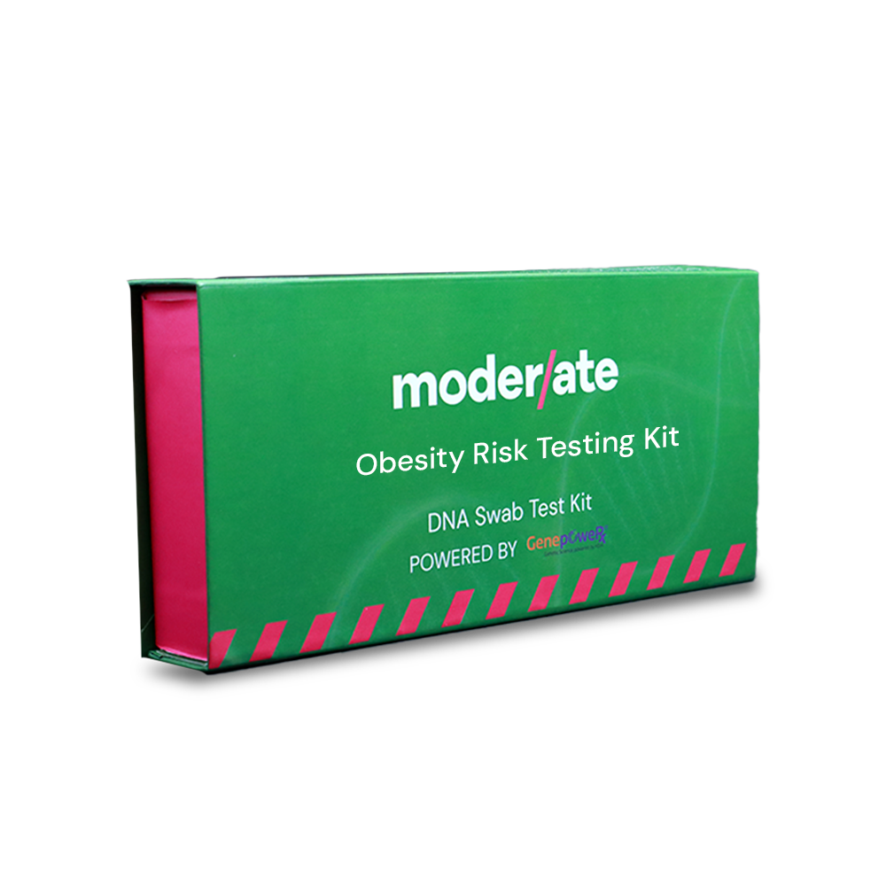
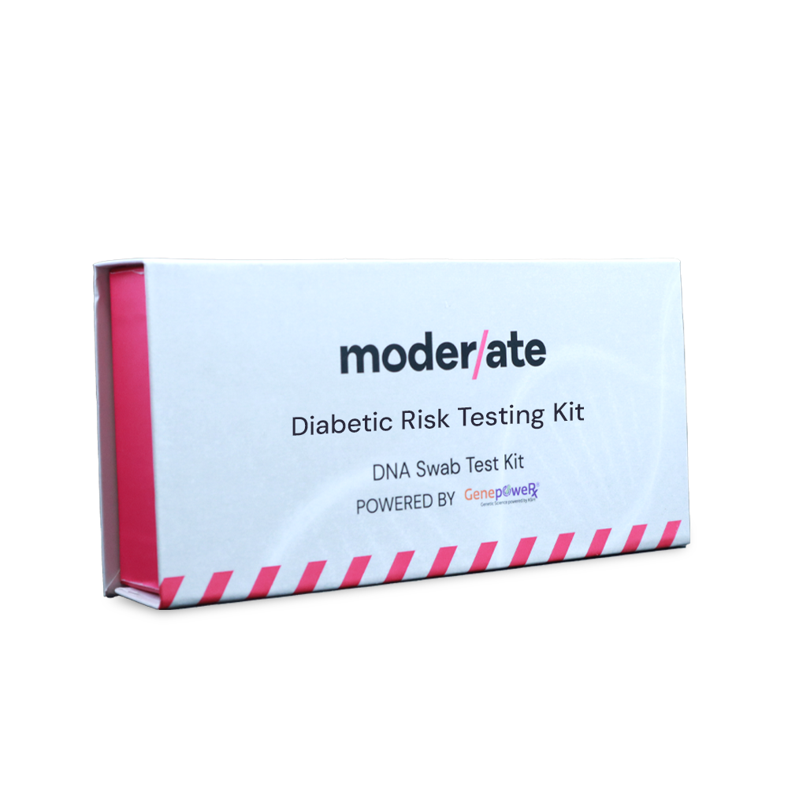
letsmoderate.com

